Slide 1

INTRODUCTION TO CREATING MAPS WITH LEAFLET
NOVEMBER 27, 2021
3:00 pm - 5:00 pm (GMT +3)

Slide 2
Agenda
Time | Activity | Speaker/ Moderator
3:00 pm – 3:05 pm | Participants joining | Njoki Lucy
3:05 pm – 3:15 pm | Welcoming remarks and introducing the speaker | Njoki Lucy
3:15 pm – 4:15pm | Introduction to creating maps with leaflet | Dr. Laurie Baker
4:15 pm – 4:45 pm | Q & A | Shel Kariuki
4:45 pm – 5:00 pm | Closing remarks | Njoki Lucy

Slide 3
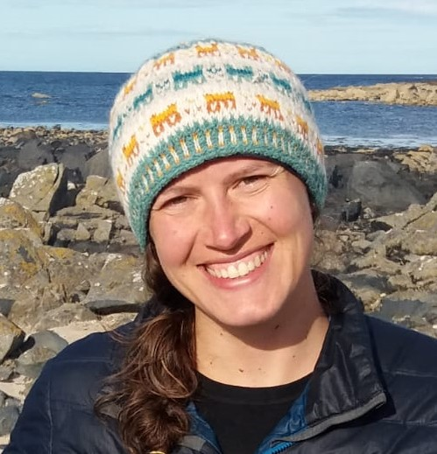
Our Trainer
Dr. Laurie Baker
Visiting Assistant Professor of Digital and Computational Studies, Bates College

Slide 4
Training Session

Slide 5
Q & A

Slide 6
THANK YOU
Email address: nairobi@rladies.org
LinkedIn: R-Ladies Nairobi
Twitter: @RLadiesNairobi
Meetup: https://www.meetup.com/rladies-nairobi/

Slide 7

Photo by Osman Rana on Unsplash

